Slide 1
Real-Time Database Integration
By Syed Minhaj

Slide 2
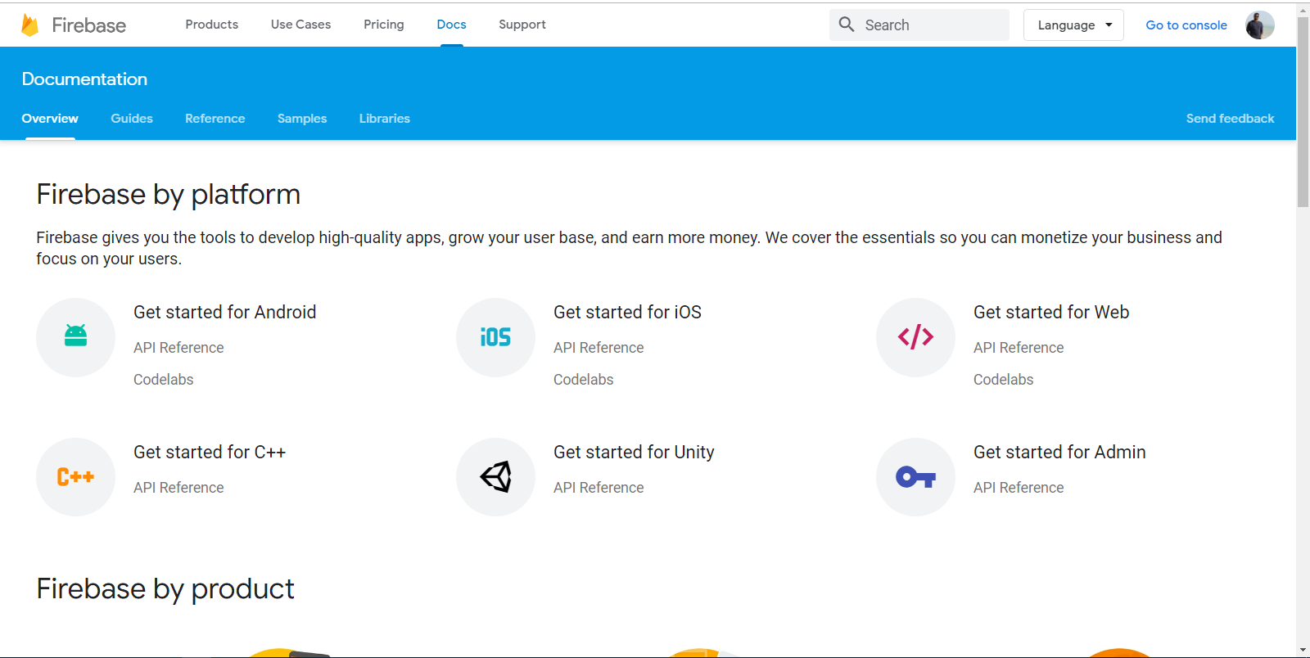
FIREBASE DATABASE INTEGRATION (1/8)
Step 1
Firebase Doc
Step 2
Click here

Slide 3
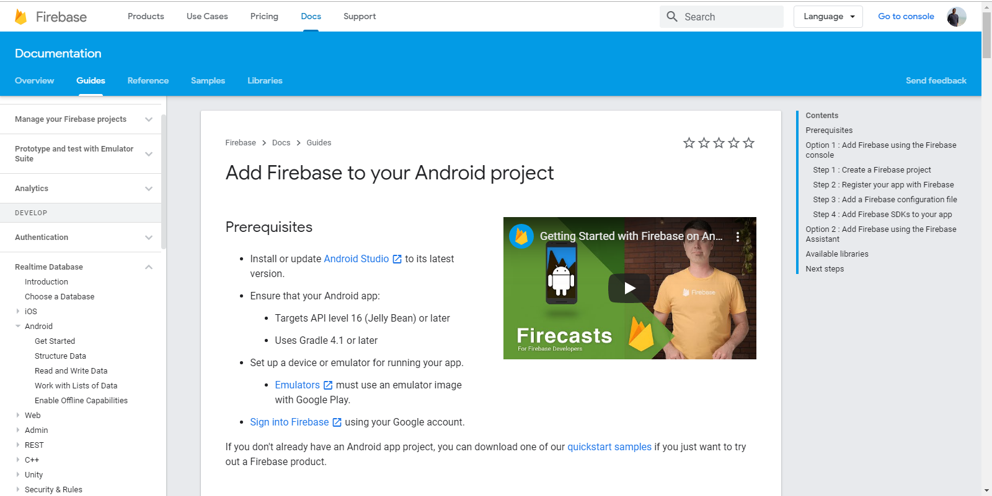
FIREBASE DATABASE INTEGRATION (2/8)
Step 3
Click here

Slide 4
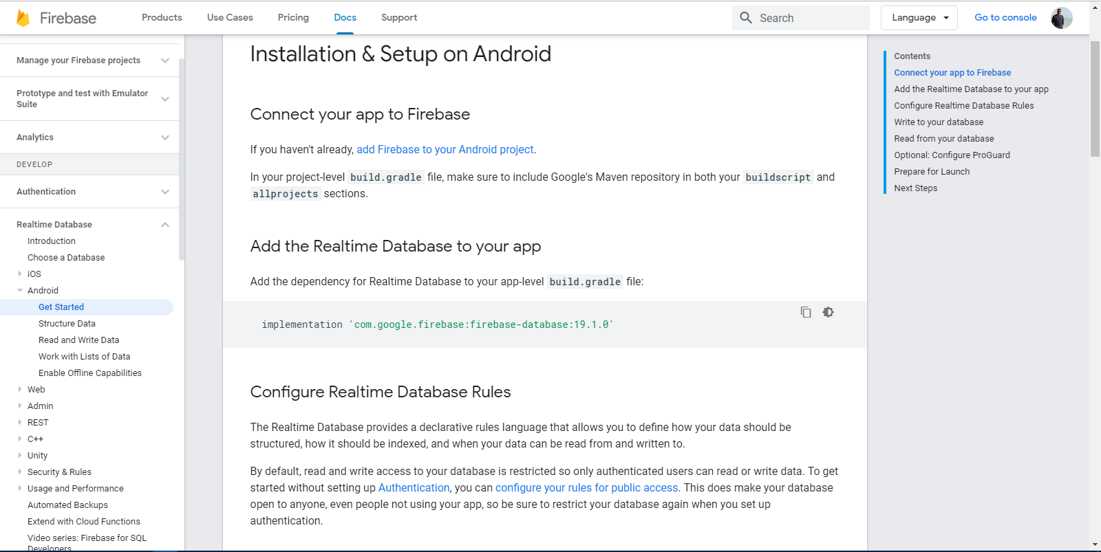
FIREBASE DATABASE INTEGRATION (3/8)
Step 4
Add dependency to your project

Slide 5
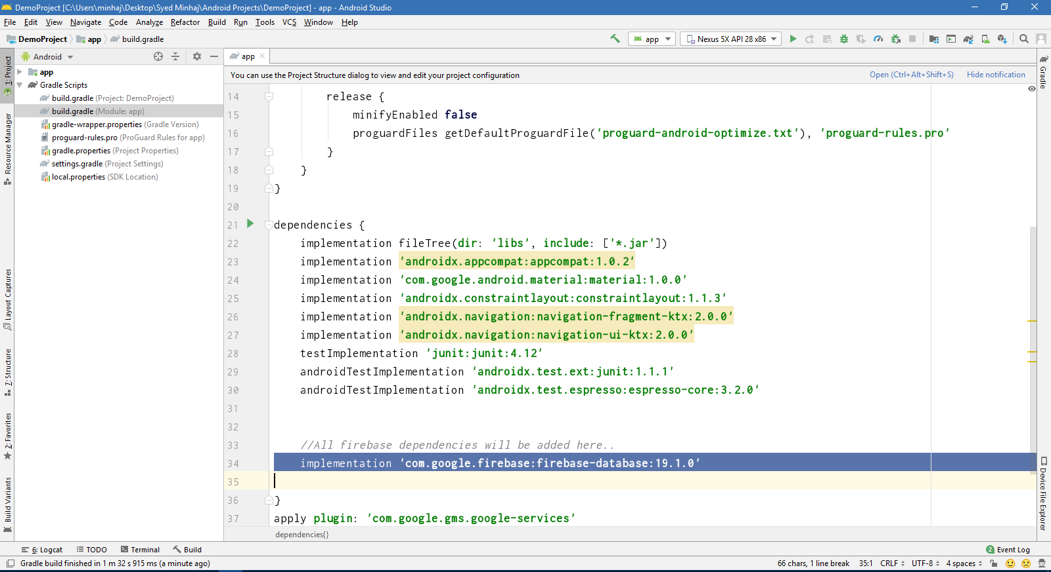
FIREBASE DATABASE INTEGRATION (4/8)
Step 5
Add dependency to your build.gradle

Slide 6
Finished Real-Time Database Integration

